Slide 1

Presented by Zhuofan Dong

Slide 2
1. Background
The objective is to create a model for predicting the default risk of payment for customers. I wish to use classification techniques in order to generate a prediction model:
- default = Yes(Oui)
- default = No(Non)
Several classifiers will be generated and tested by applying the different classification methods and adjusting parameters to optimize results. Only the most efficient classifier will be kept knowing that above all.

Slide 3
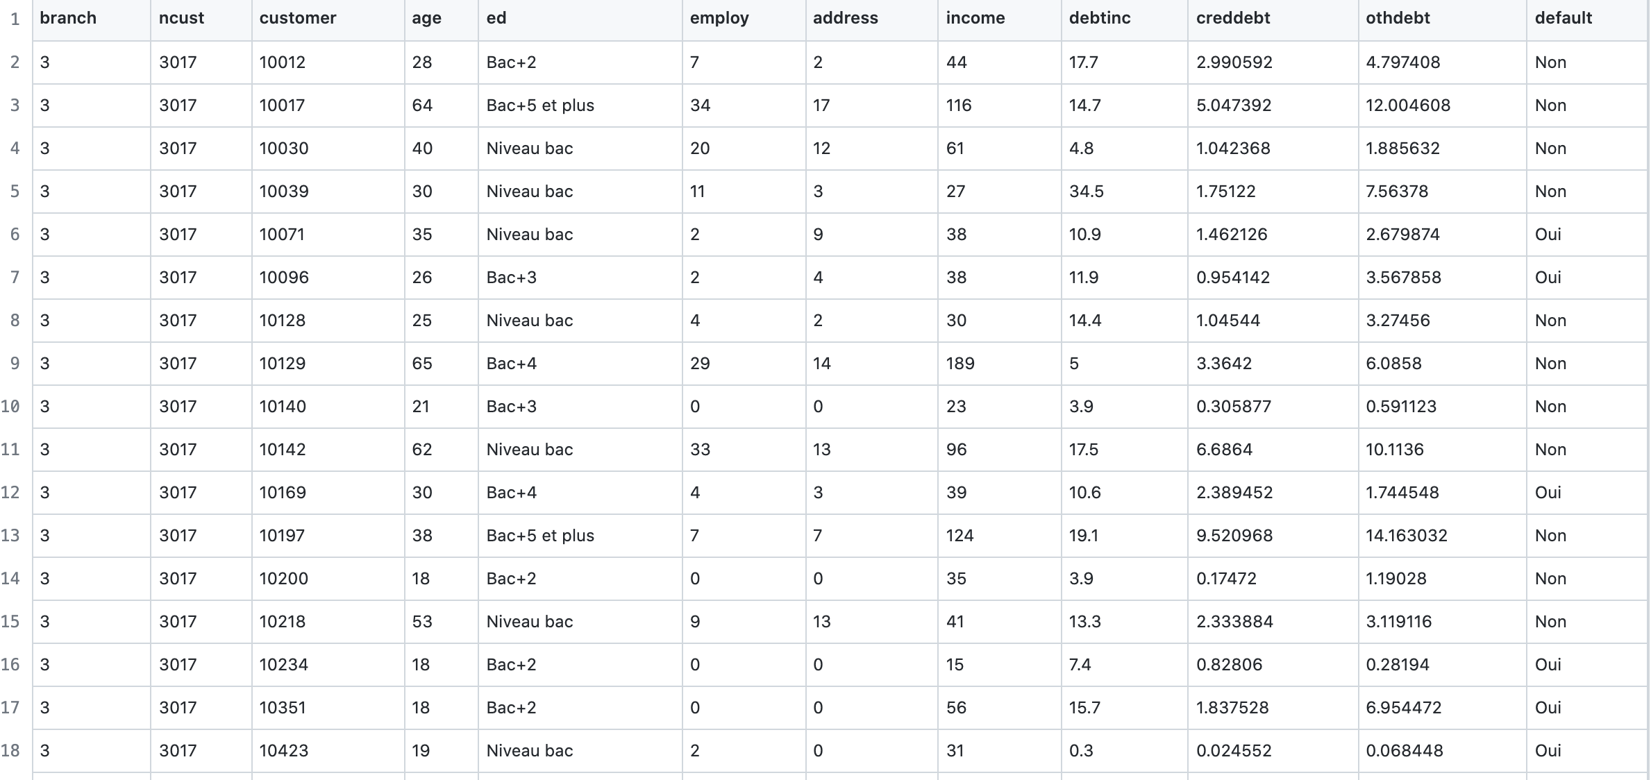
2. Data Exploration

Slide 4
2.1.1 Relationship between variables by Histograms
We first looked at the relationship between client income and whether there is a bank default.
We obtained the following histogram:

Slide 5
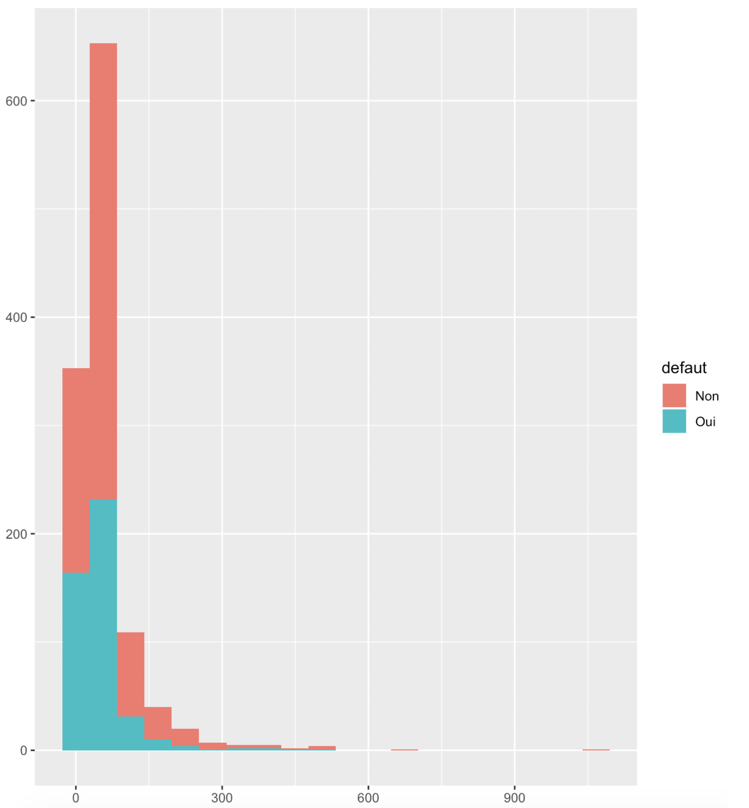
Income VS Defaults
X-axis is the income
Y-axis is the number of defaults.

Slide 6
2.1.1 Relationship between variables by Histograms
Since income is linked to employment, we then looked at the relationship between employment and default.
We thus obtained the following histogram:

Slide 7
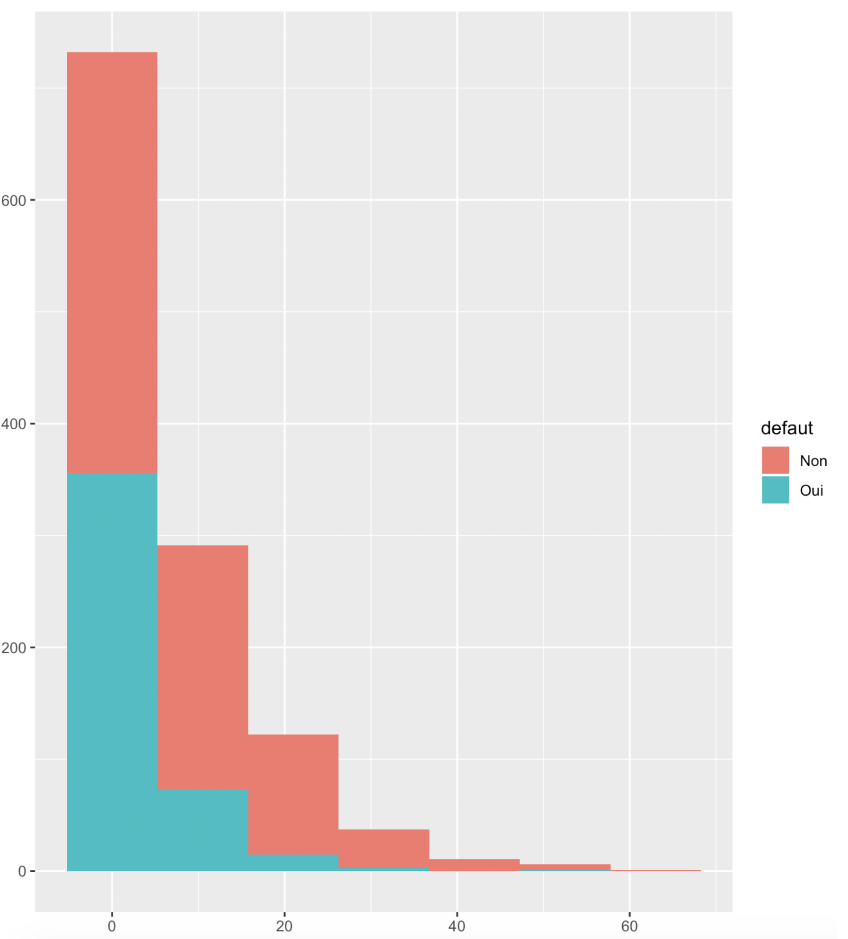
Employment VS Defaults
X-axis is the employment
Y-axis is the number of defaults.

Slide 8
2.1.1 Relationship between variables by Histograms
Finally, we are interested in the relationship between the default and address variables. The address variable is defined as the number of years the customer has not changed the where he/she lives. We obtained the following histogram:

Slide 9
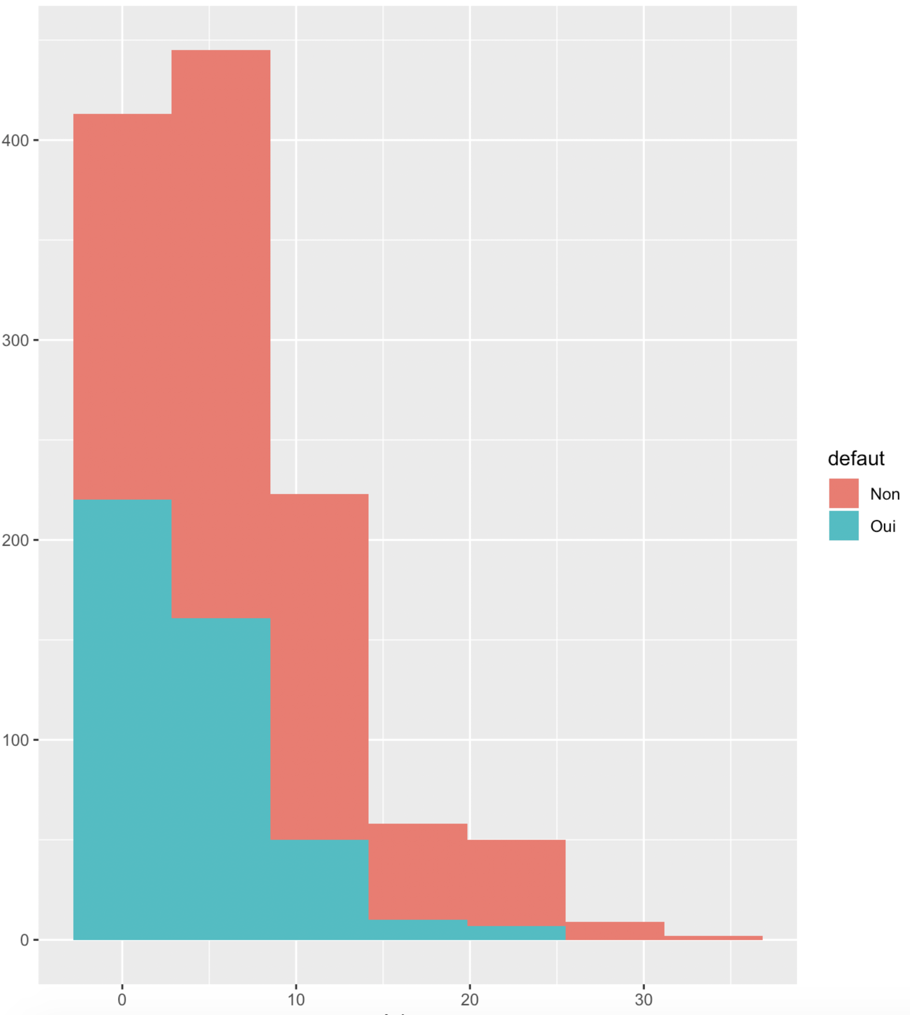
Address VS Defaults
X-axis is the address
Y-axis is the number of defaults.

Slide 10
2.1.2 Unknown relationship between variables
I also performed other histograms, for the relationships between the default variable on the age variables and the level of education. However, we were unable to identify any real relationships between these variables.
So, I used boxplot to show the relationship between these variables and defaults

Slide 11
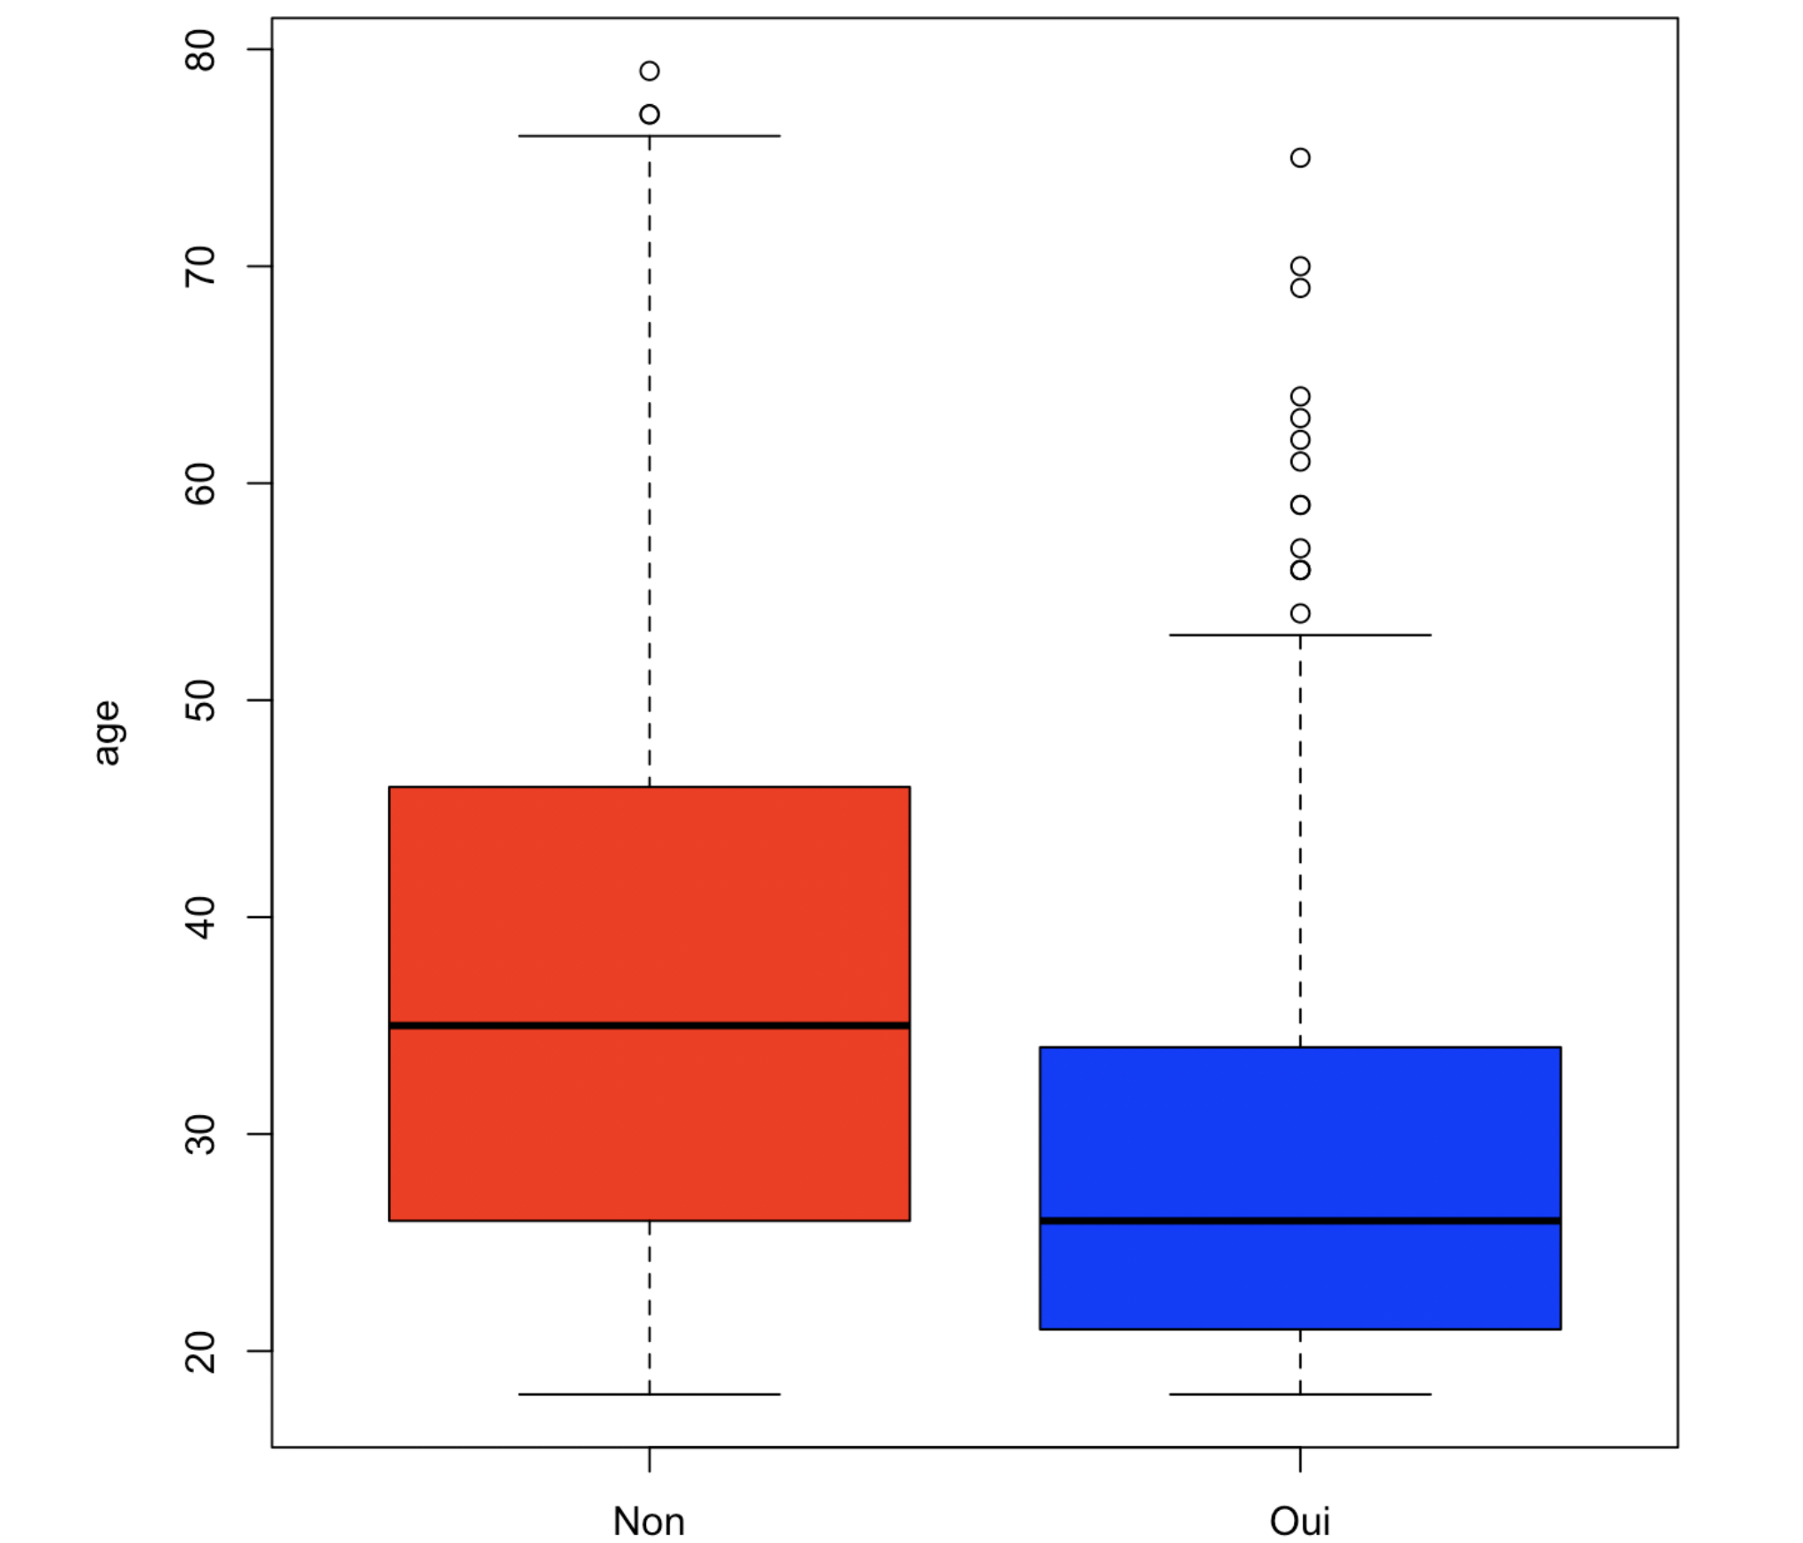
The boxplots allow me to compare two different variables
X-axis is the defaults
Y-axis is the age variable.

Slide 12
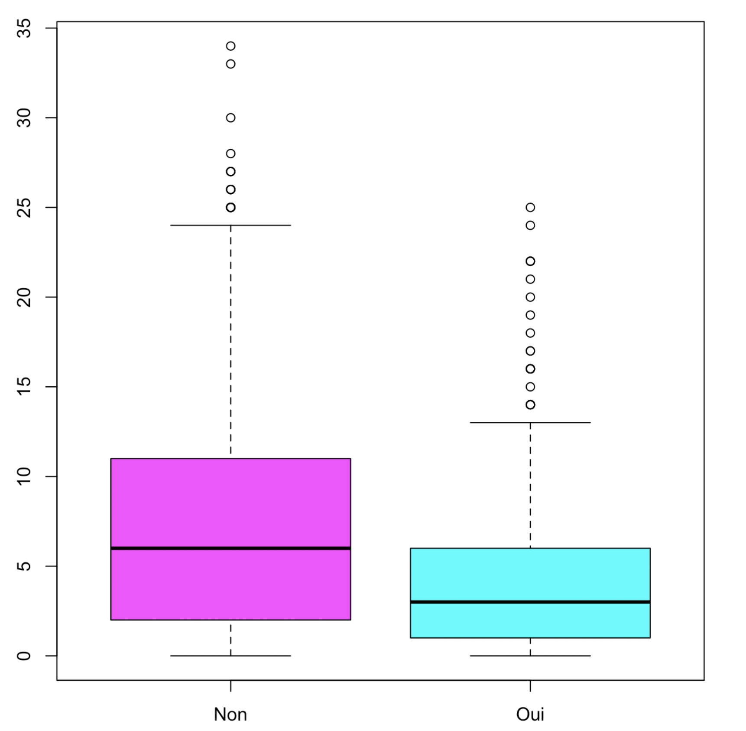
The boxplots allow me to compare two different variables
X-axis is the defaults
Y-axis is the address variable.

Slide 13
3. Classifier Evaluation
There are several ways to assess the quality of a classifier.
We can look at measures of success and failure evaluations. A success is a correct prediction on the learning set, while a failure is a false prediction on the same set. (real class = "True"; predictions = "False" indicates a bad prediction of the classifier).
“True Positives” (VP) and “True Negatives” (VN), are defined as successes. "False negatives" (FN) and "False positives" (FP) are failures.

Slide 14
3. Classifier Evaluation
Sensitivity (proportion of correctly predicted positive test examples)
Specificity (proportion of correctly predicted negative test examples)
Precision (proportion of correct positive predictions)
True Negative rate (proportion of correct negative predictions).
These metrics are used to select the classifier that maximizes success.

Slide 15
3. Classifier Evaluation
Next, we can focus on the confusion matrices of classifiers. The confusion matrix contains all the values ​​calculated previously and therefore makes it possible to judge the quality of the classifier.
In our case we have instead chosen to use the digital indicators AUC, which represents the area under the ROC curves. The higher this value, the better the classifier will be.

Slide 16
4. Creation of the learning and testing dataset
We separated our 1200 observations into two datasets by percentage split. We selected the first 800 (2/3) observations for our training set, and the remaining 400 (1/3) for our test set.

Slide 17
5. Model Selection
First, we used the classifiers from the Rpart, C5.0, and Tree libraries that we applied to the training set. We then drew the trees generated by the three classifiers. Then we applied these classifiers to the test set, to obtain the confusion matrices, and thus derive all the available information. (sensitivity, specificity, precision, and the rate of true negatives).
Despite the calculations made, we did not take the results into account, as we decided to use the AUC numerical indicators as a valuation method.
Prior to the calculation and display of our ROC curves, we calculated the prediction probabilities of YES and NO, for each classifier with respect to the default variable.

Slide 18
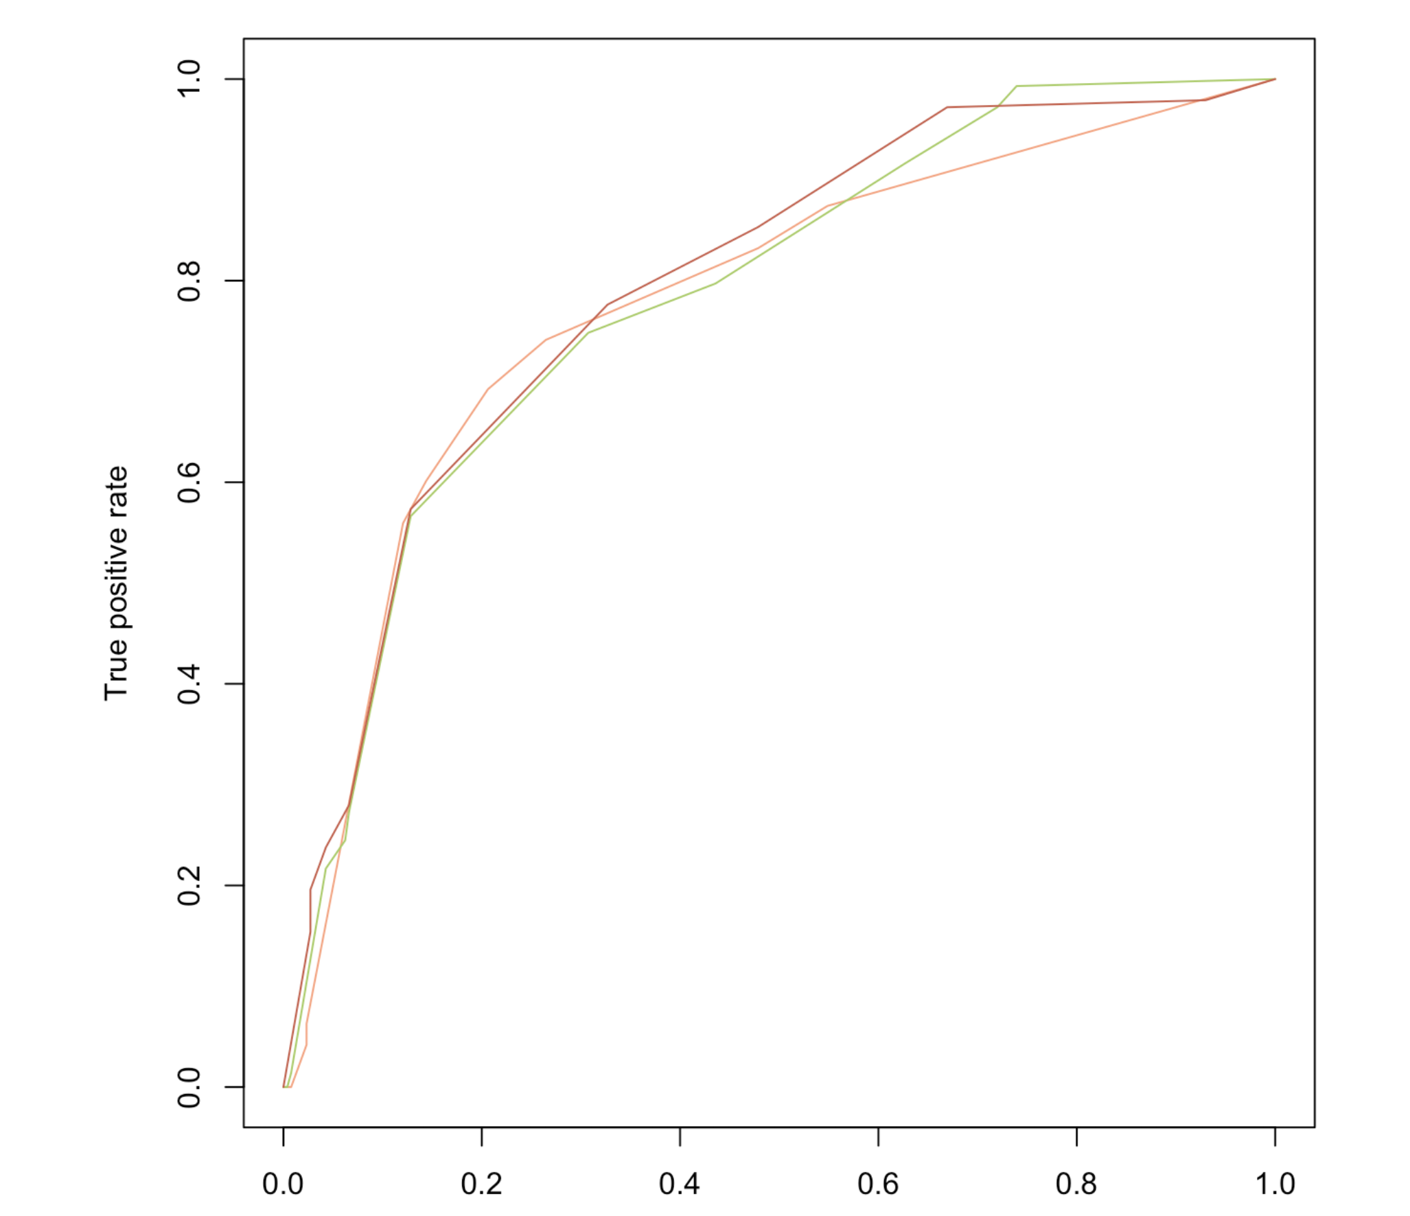
5. Model Selection
We obtained the following ROC curves for Rpart C5.0 and Tree:

Slide 19
5. Model Selection
We obtained the following ROC curves for Rpart, C5.0 and Tree
By calculating the air under the ROC curves, we obtained the following AUCs:
For Rpart: 0.7773258
For C5.0: 0.7829583
For Tree: 0.7932301

Slide 20
5.1 Random Forest
We therefore wanted to test the Random Forest classifier, which is based on Bagging and random dimension selection methods, which consist in combining different predictive models.

Slide 21
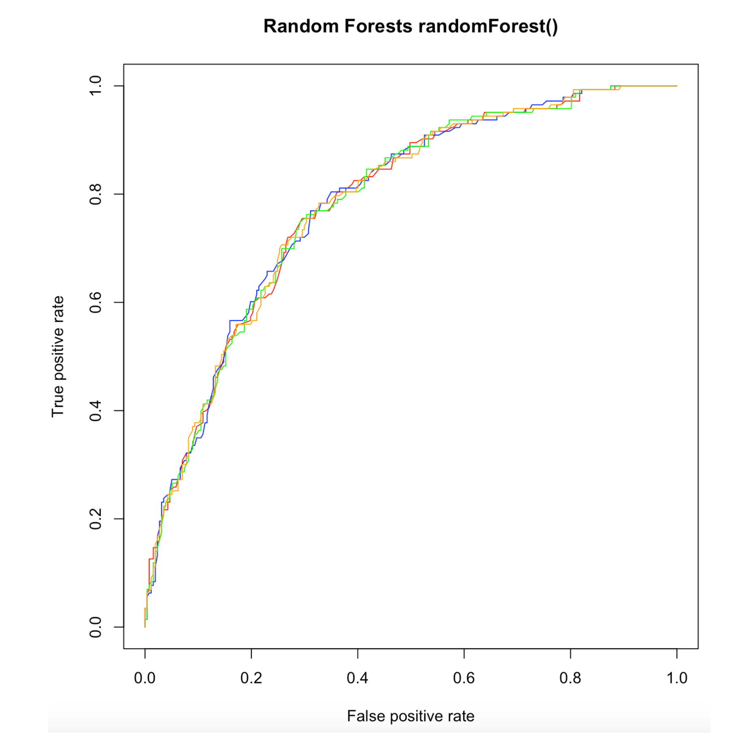
5.1 Random Forest
It gives me these ROC curves below:
As parameters in our function, we have the number of ntree trees, and the number of variables selected by mtry trees.

Slide 22
5.1 Random Forest
Red: ntree = 300, mtry = 3, AUC = 0.783148757856929
Blue: ntree = 300, mtry = 5, AUC = 0.784522870125983
Green: ntree = 500, mtry = 3, AUC = 0.782835841201601
Orange: ntree = 500, mtry = 5, AUC = 0.783638540447879

Slide 23
5.2 KNN
We then wanted to test and judge the quality of the classifier based on K-Nearest Neighbors (KNN). For this method, we use the same way as previously used to create the functions on R to perform the each step which leads to the display of the ROC curves and the calculation of the AUC values.

Slide 24
5.2 KNN
The principle of this classifier is to project the data space, where each sample is represented as a point in this data space. This point is being placed at a certain position according to the values ​​of these variables.
We then choose K, the number of "closest neighbors" considered to predict an instance, if this instance is surrounded by a predominantly class with respect to another, it is the one that will be predicted.
Of course, the calculations related to the application of this classifier take the type of data that we are going to process into account, and all of this is configured in the R library named "kknn".
As parameters in our function, we have:
- k: the number of “closest neighbors” considered
- Distance: the value of the Minkowski distance considered

Slide 25
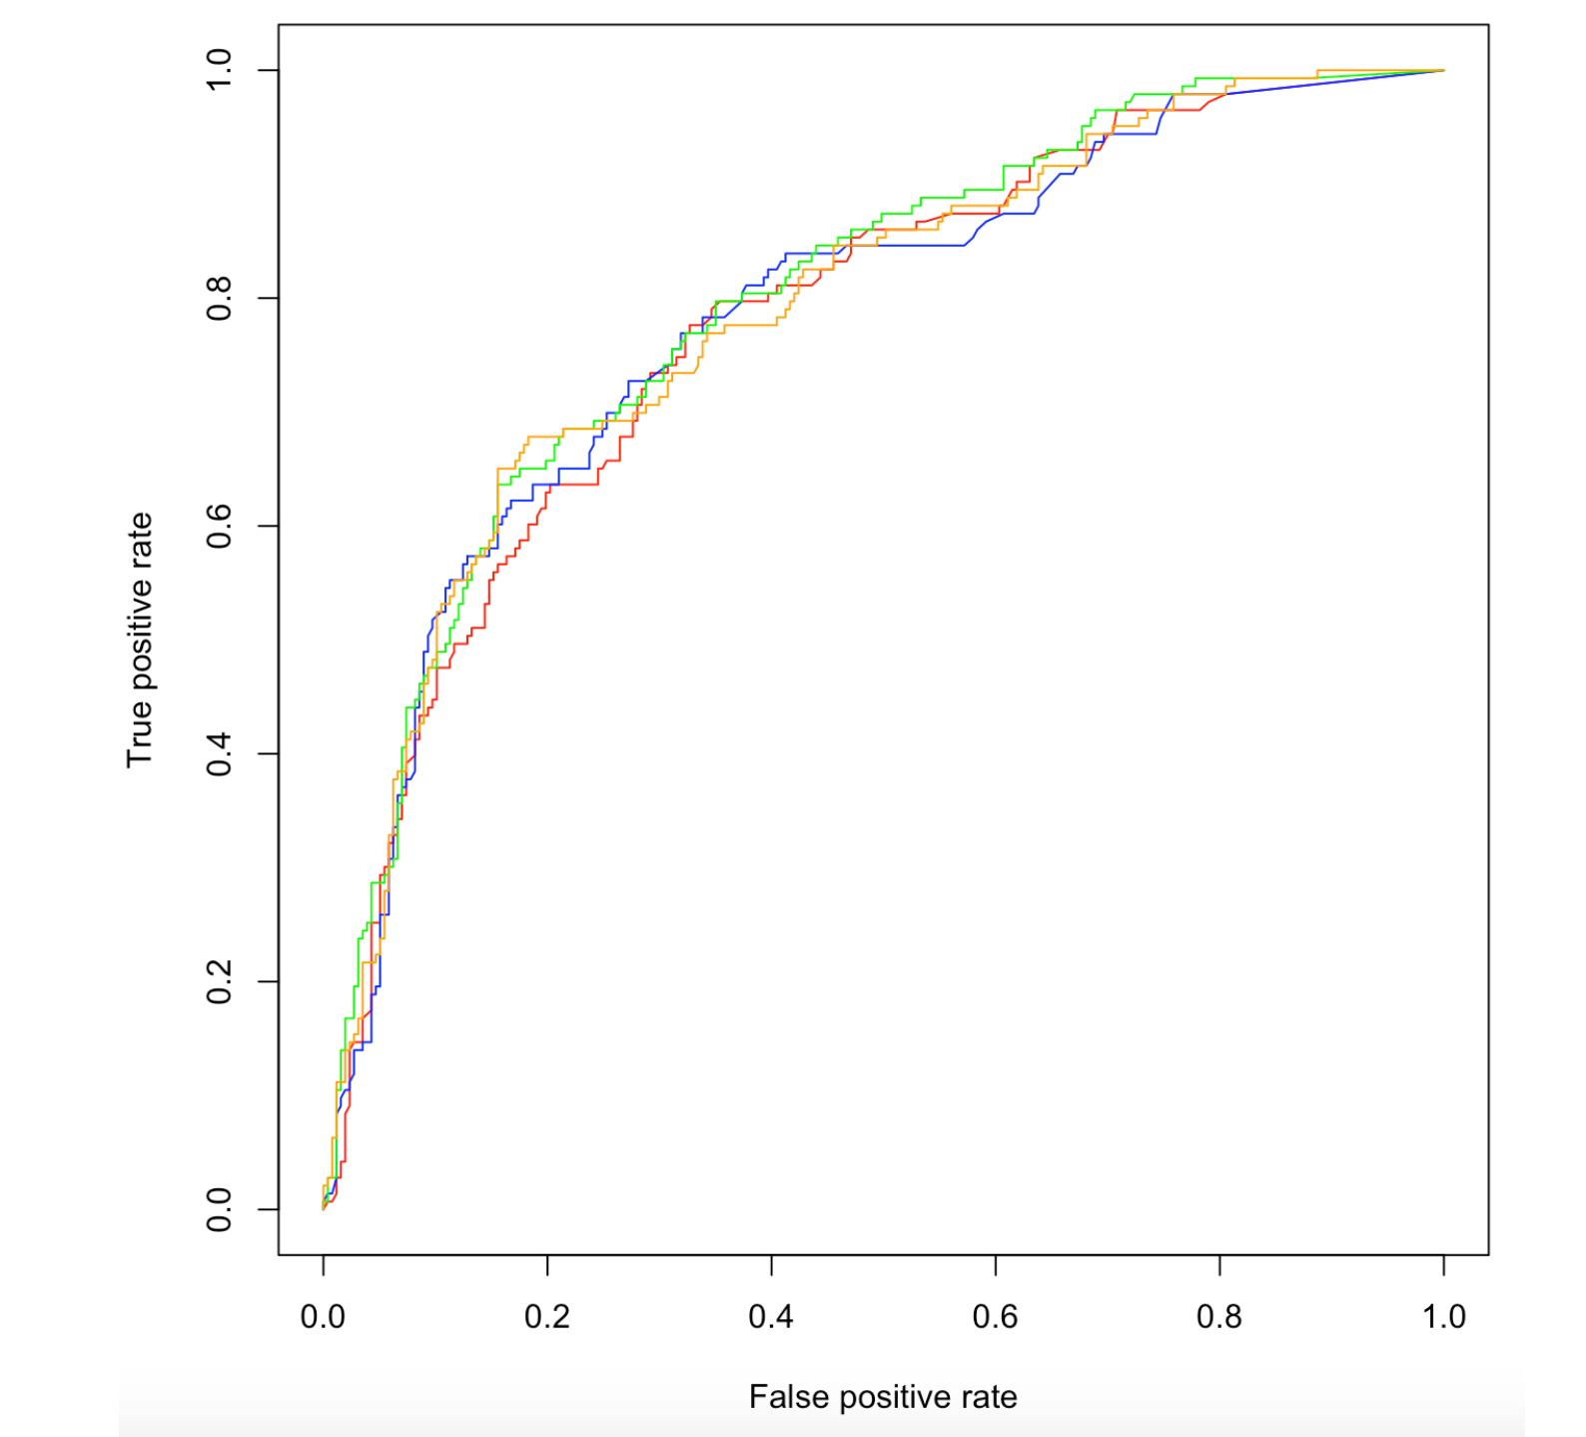
5.2 KNN
We obtained the following ROC curves for different parameters

Slide 26
5.2 KNN
We obtained the following ROC curves for different parameters:
Red: k = 10, distance = 1, AUC = 0.778795134826263
Blue: k = 10, distance = 2, AUC = 0.783107942641017
Green: k = 20, distance = 1, AUC = 0.797202797202797
Orange: k = 20, distance = 2, AUC = 0.788101004054311

Slide 27
5.2 KNN
Note that for a larger number of "closest neighbors" and a smaller Minkowski distance, the AUC of the classifier performs better.
Therefore, we subsequently wanted to test a much higher number of "k nearest neighbors", for example 100 then 200, to see if the difference was obvious in the AUCs.

Slide 28
5.2 KNN
- k = 100, distance = 1, AUC = 0.808603847514352
- k = 100, distance = 2, AUC = 0.798590514543821
- k = 200, distance = 1, AUC = 0.805637941824712
- k = 200, distance = 2, AUC = 0.796059971157247

Slide 29
5.3 Support Vector Machine
This classifier is based on the notion of hyperplane, the decisional boundary between classes. We project the data containing M variables in an M-dimensional space. Then one seeks to define a border between the sub-spaces of points of these classes. It is in a way the thickness of this border which will give the efficiency of our classifier. We will therefore try to maximize this distance which separates the two points closest to two classes, which are the support vectors. However, a problem remains, the dot products of vectors in high dimensions are very expensive, and we therefore have to use the different types of kernel functions seen in class (linear, polynomial, radial, sigmoid). This method is implemented by the “e1071” library of R, and allows us to create our classifier.

Slide 30
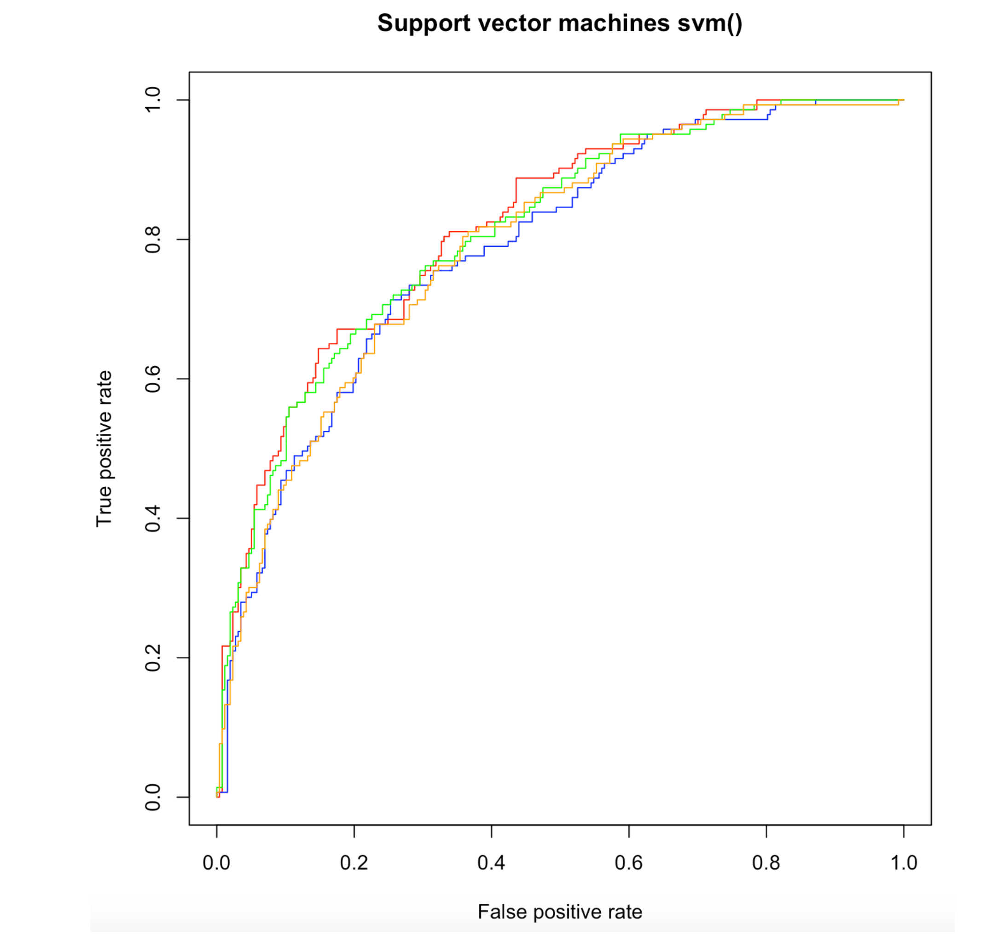
5.3 Support Vector Machine
We obtained the following ROC curves for different parameters:

Slide 31
5.3 Support Vector Machine
We obtained the following ROC curves for different parameters:
Red: kernel = linear, AUC = 0.819351854371311
Blue: kernel = polynomial, AUC = 0.786808522217082
Green: kernel = radial, AUC = 0.811433702484287
Orange: kernel = sigmoid, AUC = 0.792196130717529

Slide 32
5.4 Naïve Bayes
Once again, we used the function having the following parameters:
Laplace = intensity of Laplace smoothing, smoothing of borders decision-making between classes
- Usekernel = use of a density estimation kernel or not

Slide 33
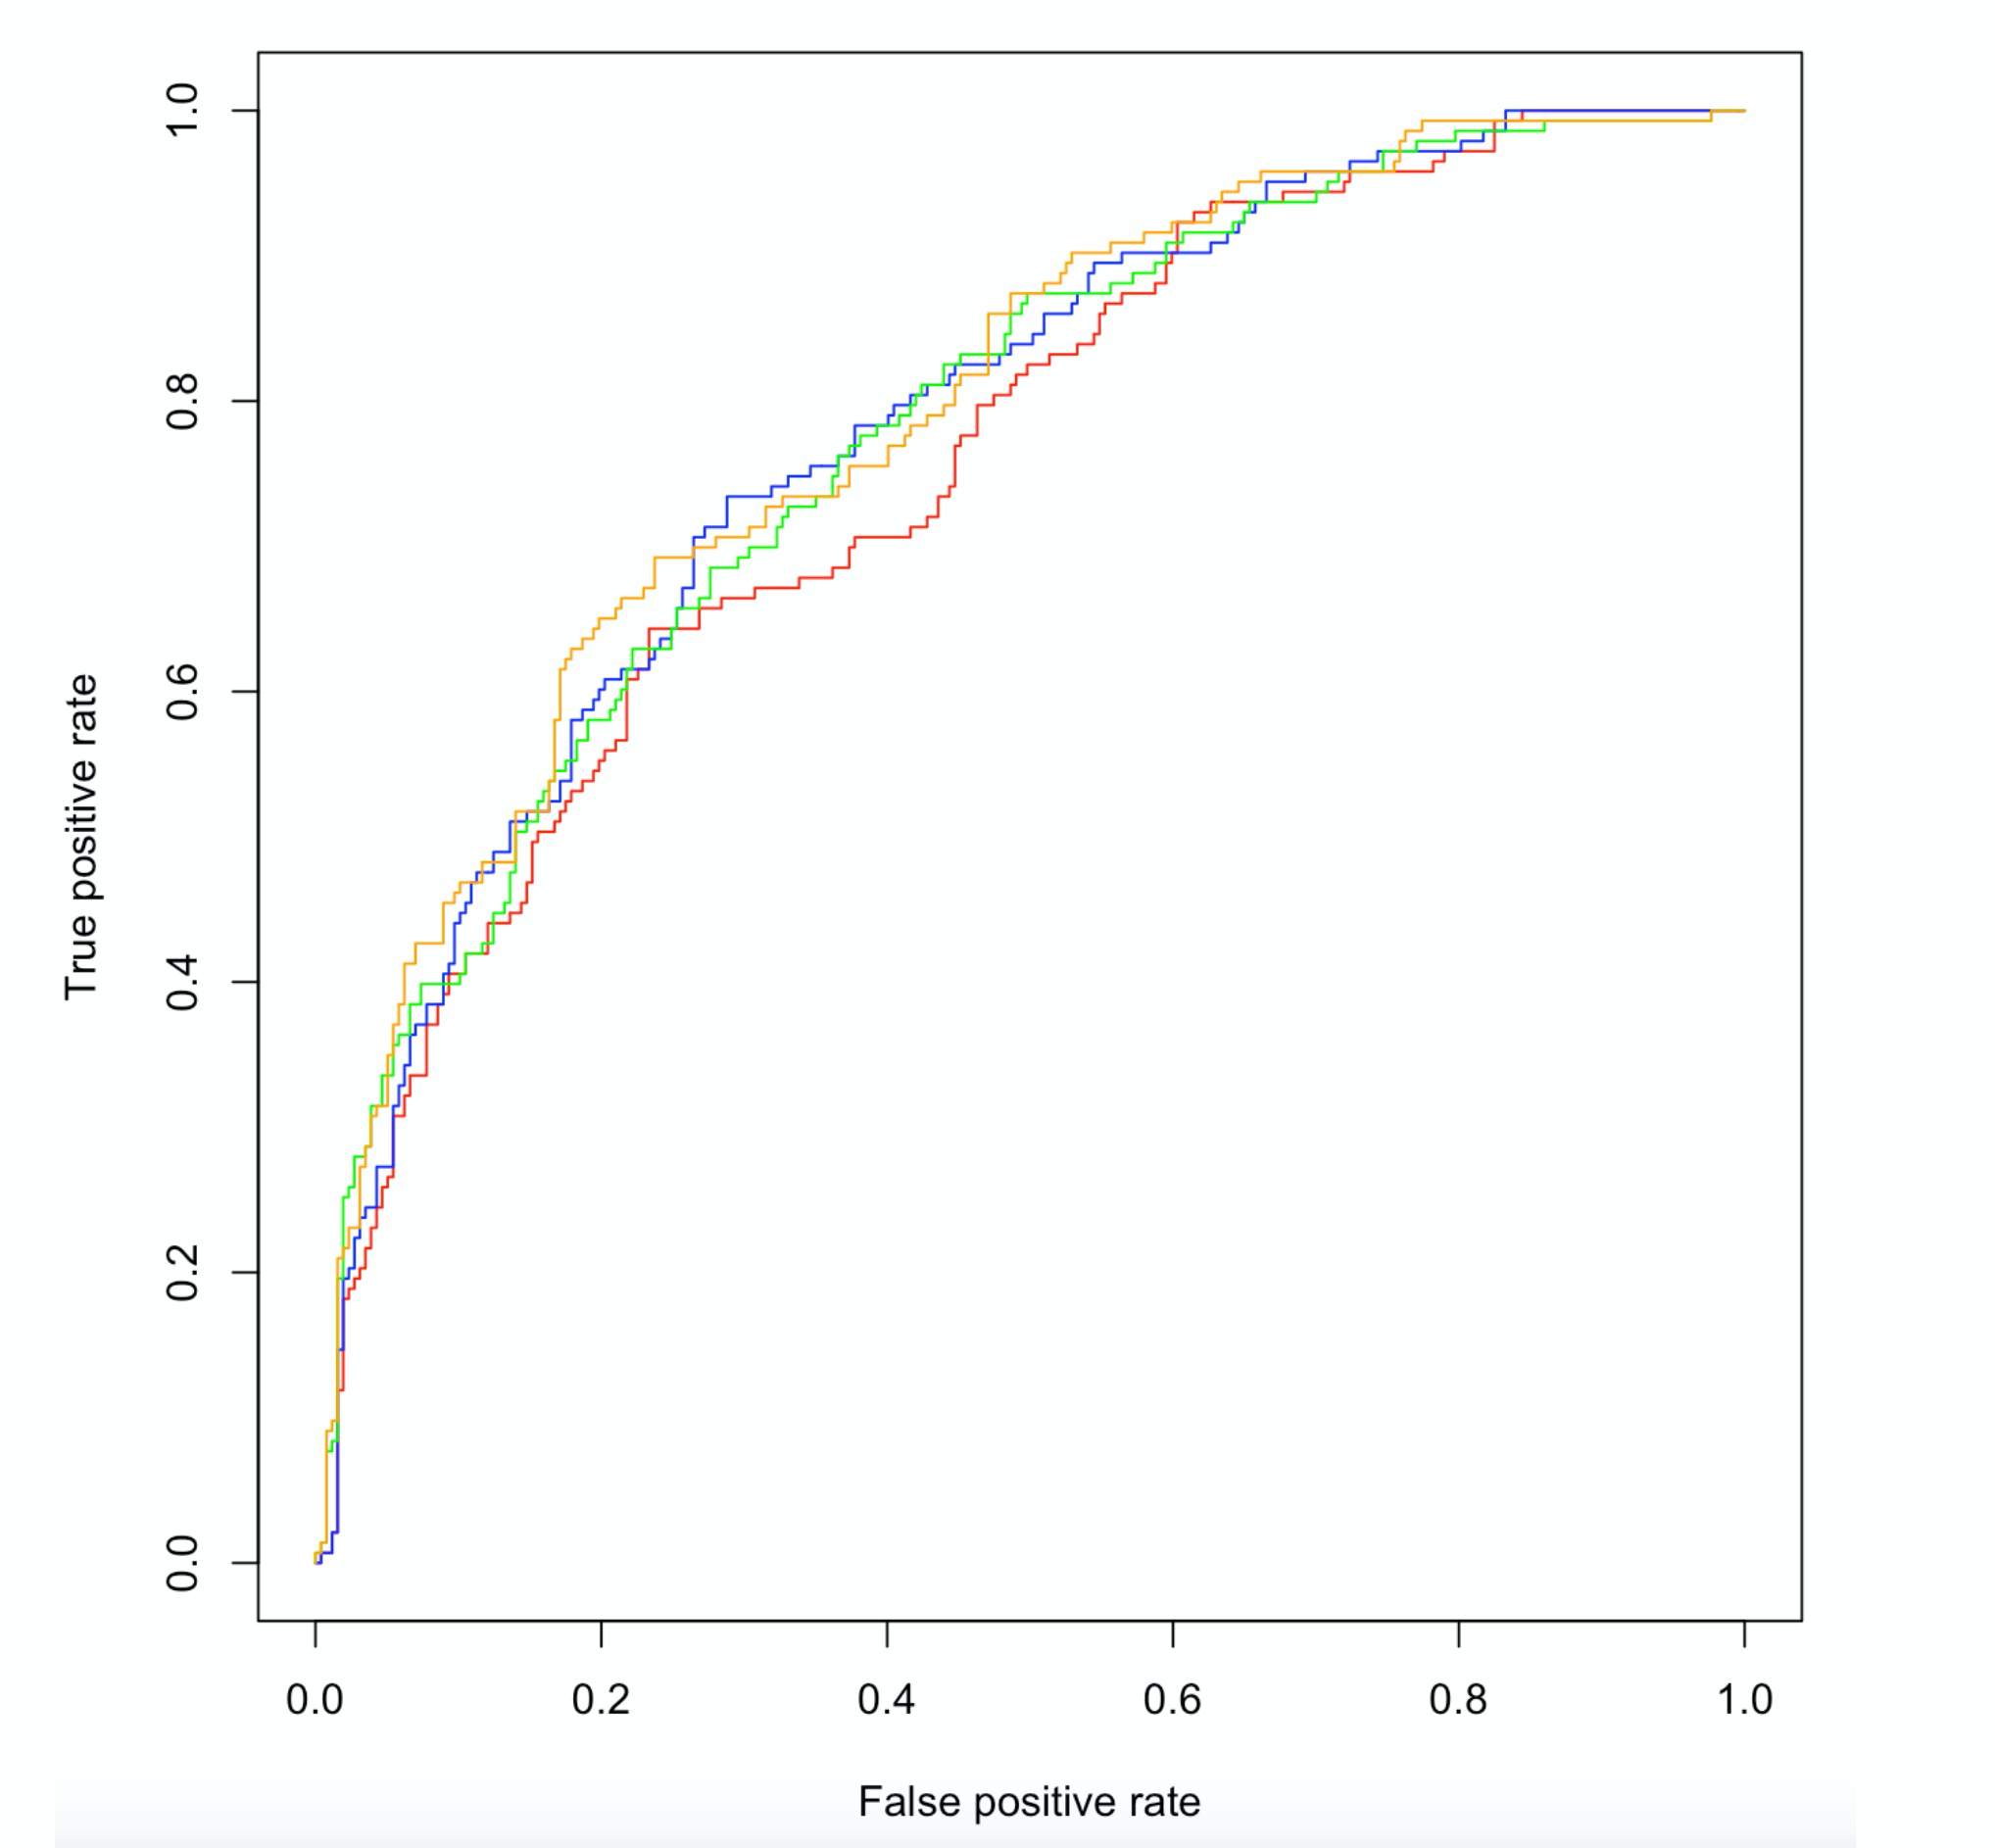
5.4 Naïve Bayes
Red: laplace=0, usekernel=FALSE, AUC = 0.753149574161247
Blue: laplace=20, usekernel=FALSE, AUC = 0.778427797883051
Green: laplace=20, usekernel=TRUE, AUC = 0.775189790753994
Orange: laplace=0, usekernel=TRUE, AUC = 0.788386710565698

Slide 34
5.4 Result
As explained previously, we decided to choose the best classifier based on the AUC index. After comparing all the indices of these classifiers for different parameters, we decided to keep the SVM classifier for our prediction. We can justify this choice by the fact that for a so-called "linear" kernel, we obtain the highest value of the AUC index of all our classifiers. We can therefore consider that in our case, and with our selection criterion, the SVM classifier will be the most efficient.
There was also consistency in our results, as we got about 67% no-default, while our baseline data included 63% no-default, which achieves the accuracy 94%.

Slide 35
6. Summary and Improvement
To conclude, we were led to think during the realization of this application, that the more the learning set would be substantial, and therefore comprising a greater number of different customer profiles, the more reliable our prediction would be. One would think that with starting data of 3 or 4 times the size, the confidence in our prediction would have been much stronger.

Slide 36
Reference
https://docs.rapidminer.com/latest/studio/operators/modeling/predictive/bayesian/naive_bayes_kernel.html
https://towardsdatascience.com/machine-learning-basics-with-the-k-nearest-neighbors-algorithm-6a6e71d01761

